Slide 1
Class and methods
In object oriented programing language, instead of directly thinking about how to solve the problem, we first think about what objects are involved in the problem domain
Then we identify the attributes and operations (functions) of those objects
This specification of attributes and operations is called a class
Operations are implemented as methods in JAVA

Slide 2
class classname [extends superclass_name]
{
[instance variables declarations]
[method declarations]
}

Slide 3
More than one classes
class Student
{
int roll;
float sem1_mrks, sem2_mrks;
}
class StudentController{
public static void main(String x[] )
{
Student s1=new Student();
Student s2=new Student();
s1.roll=7;
s1. sem1_mrks=475;
s1. sem1_mrks=525;
System.out.println(First student’s roll number:”+s1.roll);
System.out.println(First student’s 1st Sem marks:”+s1. sem1_mrks);
System.out.println(First student’s 1st Sem marks:”+s1. sem1_mrks);
System.out.println(First student’s 2nd Sem marks:”+s1. sem2_mrks);
}

Slide 4
File name
File name is always the same as the class name in which the main() method is present.
So, StudentController.java
After compilation, two .class files (i.e. bytecodes) will be generated, one for each class:
Student.class and StudentController.class

Slide 5
Assigning object reference variables
Student s1=new Student();
Student s2=s1;
Here, reference of s1 object is assigned to the object s2
So s1 and s2 contain the reference to same memory location
S1
Roll
Sem1_mrks
Sem2_mrks
S2

Slide 6
Garbage Collection and finalize() method
The garbage collector is a program that runs periodically checking for objects that are no longer referred by any program
Sometimes, the object needs to perform some actions when it is destroyed.
Eg. An object is holding some non-java resource such as a file handler. Then, you may want to free the resources before an object is destroyed.

Slide 7
To handles such situation java provides a mechanism called “finalization”.
Using this, we can specify certain actions, which will occur just before object is reclaimed by the garbage collector.
Java run-time calls the finalize() method when it is about to recycle an object of that class.
To add finalizer to a class, simply override and define the finalize() method(actually defined in lang.Object class).
But we cannot predict when the garbage collection will run….

Slide 8
What is Unreferenced object?
1. By nulling the reference:
A a = new A();
a=null;
2. By assigning ref. to another object:
A a1 =new A();
a= a1;
3. By anonymous object:
new A();

Slide 9
Defining finalize() method:
protected void finalize()
{
//cleaning activity
}

Slide 10
Argument Passing
Passing Argument and returning values in methods is same in JAVA as that in C and C++
Object as parameter:
Objects can be passed in methods or constructors as parameters
The caller passes the object reference variable as it passes any other datatype variables
The receiver has to specify the class type to receive the object in the reference variable

Slide 11
class Student{
String name; int roll, Result result;
Student(String name, int roll, Result result)
{
this.name=name;
this.roll=roll;
this.result=result;
}
void display(){
System.out.println(“Name:”+name);
System.out.println(“Roll no:”+roll);
System.out.println(“Sem1 marks:”+result.sem1_mrks);
System.out.println(“Sem2 marks:”+result.sem2_mrks);
}

Slide 12
class Result
{
float sem1_mrks, sem2_mrks;
}

Slide 13
class StudentController{
public static void main(String args[] )
{
Result res=new Result();
res.sem1_mrks=805;
res.sem1_mrks=825;
Student s=new Student(“Rahul”, 043,res);
s.display();
}
}

Slide 14
Objects as Parameters to method
We may want a method to operate on different objects
Test(int a, int b)
{
i=a;
j=b;
}
boolean checkEquality(Test ob)
{
if(ob.i== i && ob.j== j)
return true;
else
return false;
}
public static void main(String a[])
{
Test ob1=new Test(100,200);
Test ob2=new Test(100,200);
System.out.println(“ob1==ob2 is”+ ob1.checkEquality(ob2) );
}

Slide 15
Objects as Parameters to Constructor
We may want to construct a new object such that it is initially the same as some existing object.
OverloadDemo(OverloadDemo od)
{
width= od.width;
depth= od.depth;
height = od.height;
}
OverloadDemo(float w, float h, float d)
{
width= w;
depth= d;
height = h;
}

Slide 16
OverloadDemo(float x)
{
width= x;
depth= x;
height = x; }
void volume()
{
return (width*height*depth);
}

Slide 17
public static void main(String a[])
{
OverloadDemo od1 =new OverloadDemo (10,20,15);
OverloadDemo od2 =new OverloadDemo (od1);
System.out.println(“Volume for od1:”+ od1.volume());
System.out.println(“Volume for od2:”+ od2.volume());
}
}
Output:
Volume for od1: 3000.0
Volume for od2: 3000.0

Slide 18
Method overloading:
class OverloadDemo
{
void test()
{
System.out.println(“No parameters”);
}
void test(int a, int b)
{
System.out.println(“a and b:”+a+” ”+b);
}
void test(double a)
{
System.out.println(“a:”+a);
}

Slide 19
public static void main(String a[])
{
OverloadDemo od =new OverloadDemo ();
od.test();
od.test(10,20);
od.test(123.25);
od.test(88);
}
}

Slide 20
Constructor overloading:
class OverloadDemo
{
float width, height, depth;
OverloadDemo()
{
width= -1;
depth= -1;
height = -1;
}
OverloadDemo(float w, float h, float d)
{
width= w;
depth= d;
height = h;
}

Slide 21
OverloadDemo(float x)
{
width= x;
depth= x;
height = x;
}
void volume()
{
return (width*height*depth);
}

Slide 22
public static void main(String a[])
{
OverloadDemo od1 =new OverloadDemo ();
OverloadDemo od2 =new OverloadDemo (10,20,15);
OverloadDemo od3 =new OverloadDemo (2);
System.out.println(“Volume for od1:”+ od1.volume());
System.out.println(“Volume for od2:”+ od2.volume());
System.out.println(“Volume for od3:”+ od3.volume());
}
}
Output:
Volume for od1: -1.0
Volume for od2: 3000.0
Volume for od3: 8.0

Slide 23
Access Control on variables and methods
public: Accessible anywhere
default(friendly): Accessible within the class, within its sub-class of same package or any other class of same package
protected: Accessible in the same class, in its sub-class (whether the sub-class is outside or inside the same package) and in any class within same package.
private: Accessible only within its class

Slide 24
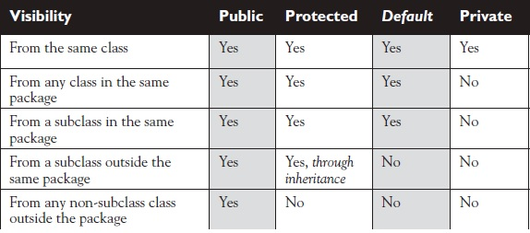

Slide 25
Final variables, methods and classes
Declaring a variable as final prevents its contents from being modified.
final int max=100;
final variables do not take space on a per instance basis.
The functionality defined in a “final method” cannot be altered in any way
All methods and variables can be by-default overridden in sub-classes
If we want to prevent the sub-class from overriding a method of its super-class, then that method should be made final.
final void findAge() {………………}

Slide 26
final class A{…….}
final class A extends SomeClass{………}
We use final class to prevent it from being extended for security reasons.
Any attempt to inherit this class will cause an error and compiler will not allow it.

Slide 27
Abstract Methods and Classes
Abstract methods are opposite to final methods
We may want some methods to always be re-defined in the sub-class, i.e. overriding is compulsory.
This is done by making a method abstract while declaration
abstract void calArea();
If a class has one or more abstract methods, it should be declared as abstract class.
Conditions:
- abstract classes do not instantiate objects.
- abstract methods of an abstract class must be defined in its sub-class
- We cannot have abstract constructors or abstract static methods.

Slide 28
Variable length arguments
Varagrs represents variable length arguments, which allows us to declare a method with unspecified number of parameters for a given argument.
Varargs must be the last argument in the argument list of a method.
Varargs is identified by the type of an argument followed by the ellipsis (…) and then the variable name
public void sample(String user, String pass, String mail_ID)
here sample() contains the same type of argument. String is used for more than one argument.

Slide 29
The same code can be replaced by varargs:
public void sample(String …account_details)
Now, we can pass any number of “String” arguments to sample() method.
Varargs can also be used as a final argument to constructors
NOTE:
At compile time, String …varargs is converted to String[] vararg (i.e. an array of Strings)
Also, we can pass an array of strings to the sample() method

Slide 30
Class Example
{
void sample(String… people)
{
for(String name: people)
System.out.println(“Hello ”+name);
}
public static void main(String a[])
{
sample(“John”,”David”,”Peter”);
}
}

Slide 31
Inheritance in Java
The class being inherited is called super-class.
The class derived after inheritance is called sub-class.
class A
{
protected int i,j;
void set_ij(int x, int y)
{
i=x;
j=y;
}
}
class B extends A
{
int total;
void sum()
{
total=i+j;
}
}
class Access{
public static void main(String a[])
{
B sub new B();
sub.set_ij(10,20);
sub.sum();
System.out.println(“Total is ”+ total);
}
}

Slide 32
Using “super”
Suppose a super-class wants to keep its data members private.
In this case, there would be no way for its sub-class to directly access or initialize those data members on its own.
Java provides a solution to this situation that, whenever a sub-class needs to refer to data members of its immediate super-class, it can do so by using keyword “super”.
super(parameter list);
parameter list specifies the parameters needed by the constructor of the super-class
super must always be the first statement executed inside the sub-class constructor

Slide 33
class Box
{
private double width, height, depth;
public Box()
{
width=height=depth=-1;
}
public Box(double w, double h, double d)
{
width=w;
height= h;
depth= d;
}
protected double volume()
{
return(width*height*depth);
}
}

Slide 34
class BoxWeight extends Box
{
double weight;
public BoxWeight()
{
super();
weight=-1;
}
public BoxWeight(double w, double h, double d, double m)
{
super(w,h,d);
weight=m;
}
}

Slide 35
class BoxDemo
{
public static void main(String a[])
{
BoxWeight b1=new BoxWeight();
BoxWeight b2=new BoxWeight(10,20,15,30.5);
double vol;
vol=b1.volume();
Sytem.out.println(“Volume of Box 1:”+vol);
Sytem.out.println(“Weight of Box 1:”+b1.weight);
vol=b2.volume();
Sytem.out.println(“Weight of Box 2:”+b2.weight);
}
}

Slide 36
Another use of super keyword:
When a sub-class calls super(), it is calling constructor of its immediate super-class.
class A
{
private int i;
}
class B extends A
{
int i; // hides i of class A
public B(int a, int b)
{
super.i=a; //i of A class being initialized
i=b;
}
void show()
{
System.out.println(“i of super-class:”+super.i);
System.out.println(“i of sub-class:”+i);
}
}

Slide 37
class UseOfSuper
{
public static void main(String a[])
{
B sub =new B(1,2);
sub.show();
}
}
Remember:
Constructors are invoked in the order of derivation, i.e. from super-class to sub-class.
If super() is not explicitly used in the constructor of sub-class, then the default constructor of the super-class will be executed
super and “this” can also be used in any base class (parent class) to call its own constructor.

Slide 38
class A
{
public A()
{
System.out.println(“Inside class A”);
}
}
class B extends A
{
public B()
{
System.out.println(“Inside class B”);
}
}
class C extends B
{
public C()
{
System.out.println(“Inside class C”);
}
}
class Calling
{
public static void main(String a[])
{
C c =new C();
}
}

Slide 39
Multi-Level Hierarchy
Write a program to exhibit multi-level inheritance.
Class Box contains 3 private members(width, height, depth),a constructor with 3 parameters and a constructor with object as parameter, also a method to calculate volume,
Class BoxWeight contains 1 member(weight), a constructor with 4 parameters and a constructor with object as parameter,
Class Shipment contains 1 member(cost), a constructor with 5 parameters and a constructor with object as parameter.
Finally, instantiate the sub-class Shipment from a separate class and display volume, weight and cost of 2 boxes.
Box
BoxWeight
Shipment

Slide 40
Method overriding
With inheritance, methods defined in super-class are inherited by its sub-class and are invoked by the objects of sub-class
But, we may want the same method to behave differently in sub-class
For this, we have to override the method.
This is done by re-defining the method of super-class again in the sub-class, with same name, same arguments and same return type but different functionality.
class Super
{
int x;
public Super(int x);
{
this.x=x;
}
void display()
{
System.out.println(“Super x=”+ x);
}
}

Slide 41
class Sub extends Super
{
int y;
Sub(int x, int y)
{
super(x);
this.y=y;
}
void display()
{
System.out.println(“Super x=”+ x);
System.out.println(“Sub y=”+ y);
}
class OverrideTest
{
public static void main(String a[])
{
Sub s = new Sub(100,200);
s.display();
}
}

Slide 42
Dynamic method dispatch
In this mechanism, method overriding is resolved at run-time instead of compile time.
class Super
{
public void method()
{
System.out.println(“In method of Super”);
}
}
class Sub extends Super
{
public void method()
{
System.out.println(“In method of Sub”);
}
}
Class Dyn_Dispatch
{
public static void main(String a[])
{
Super a =new Sub();
a.method();
}
}

Slide 43
a.method() will invoke the Sub class version of method(), although ‘a’ is a Super type variable
Thus, in dynamic dispatch method, the type of reference is irrelevant while choosing a particular version of overridden method for invocation.
Hence, Dynamic method dispatch is used to implement runtime polymorphism in JAVA

Slide 44
The ‘Object’ class
The Object class is super-class of all the other classes i.e. any existing class or class being created will be sub-class of Object class.
Object class resides in “java.lang” package i.e. the default package
Object class methods:
Object clone():
Creates a new object that is same as the object being cloned.
boolean equals(Object ob):
Determines whether the object passed as argument is equal to the object with which equals() is called.

Slide 45
void finalize():
Called just before an unused object is to be recycled.
Class getClass():
To obtain the class of an object at run-time.
void notify():
Resume the execution of a thread waiting on a invoking object.
6. void notifyAll():
Resume the execution of all threads waiting on a invoking object.
7. String toString():
Returns a string describing the object (converts the object contents to string).
void wait()
void wait(long microseconds, long nanoseconds):
Waits on another thread of execution.

Slide 46
Packages and Interfaces
Packages are Java’s way of grouping classes and/ or interfaces
Organizing classes into package we achieve following benefits:
Classes contained in package can be easily reused
Classes in a package are unique when compared with classes of other package( two classes in two different packages can have same name)
Packages provide a way to hide classes
Packages provide a way for separating “design” from “coding”

Slide 47
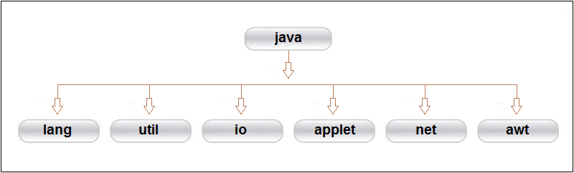
JAVA API packages
java.lang: Classes needed by compiler and hence automatically imported
java.util: Utility classes(Vector, Table, Calendar, etc.)
java.io: Classes for providing input output facility.

Slide 48
java.awt: classes for implementing GUI.
java.net: Classes for networking(both with local and internet servers)
java.applet: classes for creating and implementing applets

Slide 49
Ways of accessing Classes in Packages
Use fully qualified class name of the class that we want to use.
For eg. java.awt.Color.darker();
2. import statement
import packagename.classname;
or
import packagename.*;

Slide 50
Creating packages
use ‘package’ keyword to declare the package
Package declaration must be the first statement in the Java source file.
Followed by any import statements
Followed by class definition
package firstpackage;
class FirstClass
{
:
}

Slide 51
Using packages
package pack1;
public class A
{
public void display()
{
System.out.println(“In class A”);
}
}

Slide 52
package pack2;
import pack1.A;
public class B
{
public static void main(String a[])
{
A a=new A();
a.display();
}
}

Slide 53
Hiding classes (access protection)
What does p1.p2.*; do?
Although purpose of creating packages is to provide reusability, we may want to hide certain classes.
Such classes should not be declared as public.
package p1;
public class X
{
:
}
class Y
{
:
}

Slide 54
import p1.*;
X objx; //valid, class X is available here
Y objy; //Invalid, class Y is not available

Slide 55
Interfaces
Similar to class but with some differences:
They define only abstract methods
The data members are always final(constants)
Cannot declare objects
Interfaces are always public
Interfaces can extend any number of interfaces

Slide 56
interface Item
{
static final int code=1001;
final String name=“abc”;
void display();
}
NOTE:
Even if any data member of interface is not declared as final, still it is implicitly final and cannot change

Slide 57
interface vs abstract class
Interface has only abstract methods; abstract class can have both abstract and normal methods
A class can implement any number of interfaces
Interface can’t provide implementation for abstract class methods

Slide 58
Extending interfaces
interface itemconstants
{
int code=1001;
String name=“Fan”;
}
interface itemmethods extends itemconstants
{
void display();
}
interface item extends itemconstants, itemmethods
{
:
:
}

Slide 59
Implementing Interfaces
class classname implements interface_name
{
:
}
class class_name extends super_class implements interface1, interface2,…….interface_n
{
:
}
NOTE: This how JAVA implements Multiple Inheritance

Slide 60
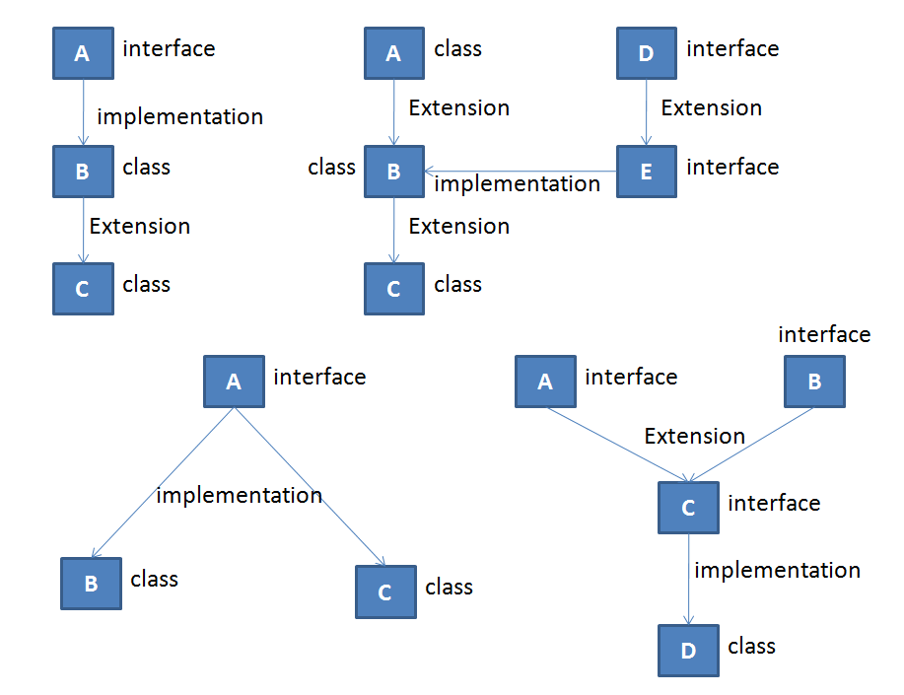
Forms of implementation

Slide 61
Accessing interface variables
Interfaces can be used to declare a set of constants used by classes that implement these interfaces
These values can be used in any method, as part of any variable initialization or any expression
interface a
{
int m=10;
int n=50;
}
Class A implements a
{
int x=m;
void method(int size)
if(size<n)
{
:
:
}
}

Slide 62
interface area { double pi=3.14; double compute(double x,double y); }
class Rect implements area { public double compute(double x,double y) { return x*y; } }

Slide 63
class Tri implements area { public double compute(double x,double y) { return x*y/2; } }
class Circle implements area { public double compute(double x,double y) { return pi*x*x; } }

Slide 64
class Area_Demo { public static void main(String arg[]) { Rect r=new Rect(); Tri t=new Tri(); Circle c=new Circle(); System.out.println(“The area of rectangle is:”+r.compute(10,20)); System.out.println(“The area of Triangle is :”+t.compute(10,12)); System.out.println(“The area of Circle is :”+c.compute(10,12)); } }

